Slide 1

Twitter Sentiment Analysis
Submitted by:
Tushar Pagadala Ashok
Akhil Kaundinya Metlakunta
Jackson Alexander Nikhitha Dasi Srinivas

Slide 2
Sentiment analysis
Algorithm used for classifying text data according to their polarity, feelings and emotions, urgency and even intentions
Extract subjective information from original data providing better sense of how customers are talking about their products and services, to get insights about business and to identify product issues.
Our Objective is to determine whether the data(tweet) is positive, negative or neutral

Slide 3
Algorithms Used
Bidirectional - LSTM using Neural Networks
Using CNN with Hyper-parameter Tuning
RNN with Hyper-Parameter Tuning
Notes:
Stale Slide – to be reviewed

Slide 4
Data Pre-Processing
Statistical Text Analysis
Finding Text Length & Word frequency
Text Length Analysis
Word Count Analysis
Most Frequent Words In Each Sentiment
Word Cloud For Tweets Based On Sentiments
Unique Words
Checking for Null values
Standardization
Removing Contractions
Tokenization
Stopwords Removal
Parts-of-Speech Tagging
Lemmatization

Slide 5
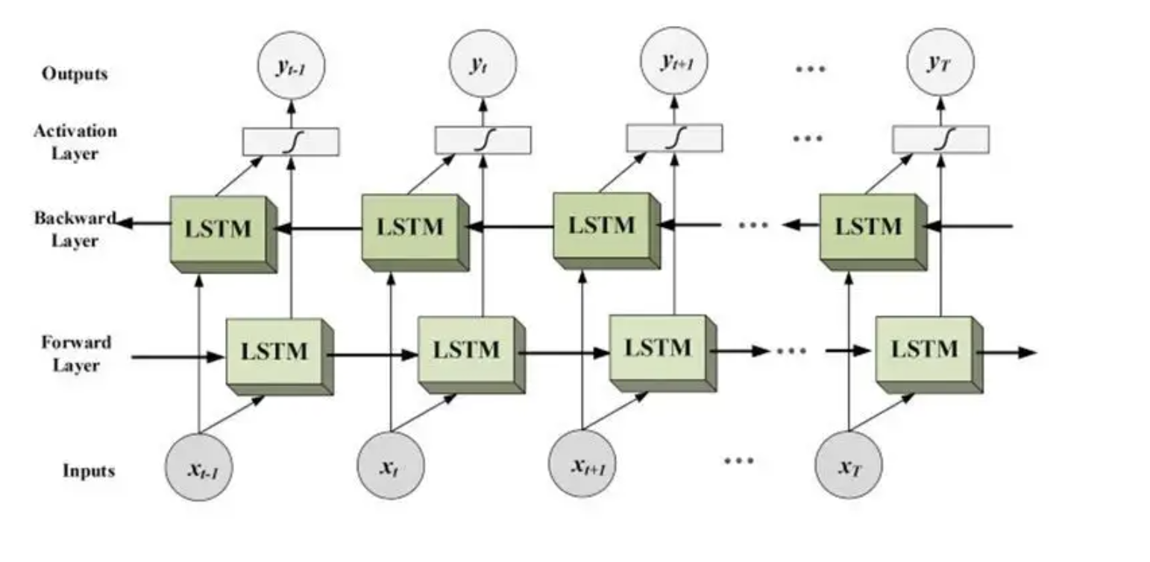
Bidirectional - LSTM using Neural Networks
Variant of RNN which has inherent feature to learn from the past
Following a Bidirectional approach
Split training and valdiation set
Tokenize the data
Pad the sequences to vectorize the tweets
We will use 'relu' activation for hidden layers, SGD optimizer, cross entropy and SoftMax activation at the output layer

Slide 6
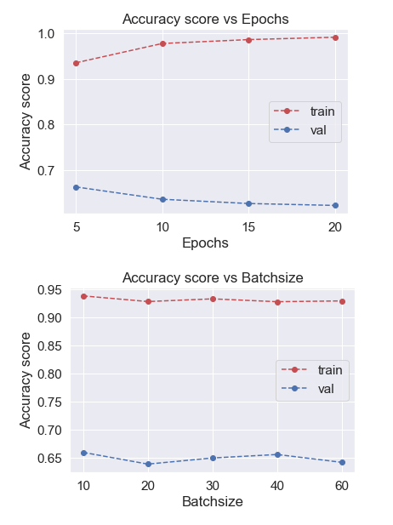
CNN with Hyper-parameter Tuning
To figure out the relationship between words in dataset
Convert the 'Sentiment' into categorical codes
CNNs achieve state-of-the-art results on problems such as document/text classification used in sentiment analysis and related problems
Building the model with Optimal hyperparameters
Use 'tanh' activation for hidden layers, SGD optimizer, cross entropy and SoftMax activation at the output layer
[ ]

Slide 7
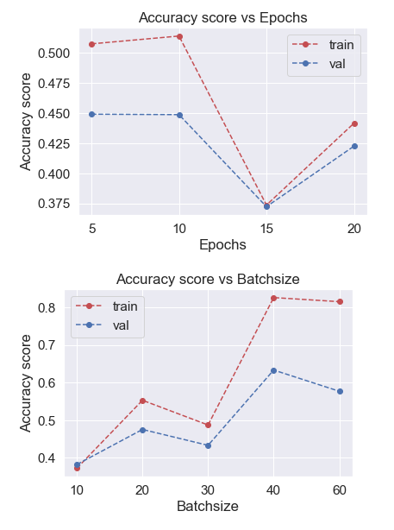
RNN with Hyper-Parameter Tuning
Text and pattern recognition
Model training
Convert the 'Sentiment' into categorical codes, define the model and find the best hyper parameters to get the most optimal results
Normalization
we will use 'softmax' as default activation function for hidden layers, SGD optimizer, cross entropy

Slide 8
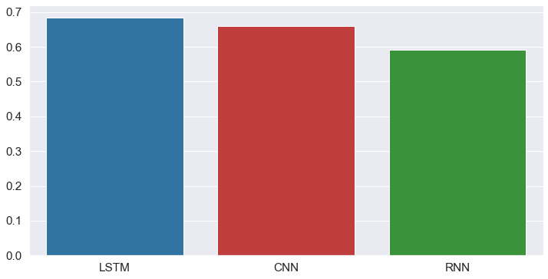
Conclusions
To analyze social network sentiment, we suggest using bidirectional LSTM model.
When compared to the other models, the bidirectional LSTM model delivers better accuracy.
The vanishing gradients or long-term dependence problem of RNNs is overcome by LSTM networks.
LSTM combats gradient vanishing by disregarding unnecessary data and information in the network and not doing so.
The accuracy of the RNN would be impacted by the size of the data, but the LSTM would continue to provide better accuracy.
LSTM produces higher results but takes longer to process, while CNN needs less hyperparameter adjusting and monitoring.

